Slide 1
Genomic Data Commons (GDC) Lab
Instructor: Prof. Young cho
Mohammad Mohsin Sheikh
Sukruth Kumar
Sourabh Kumar

Slide 2
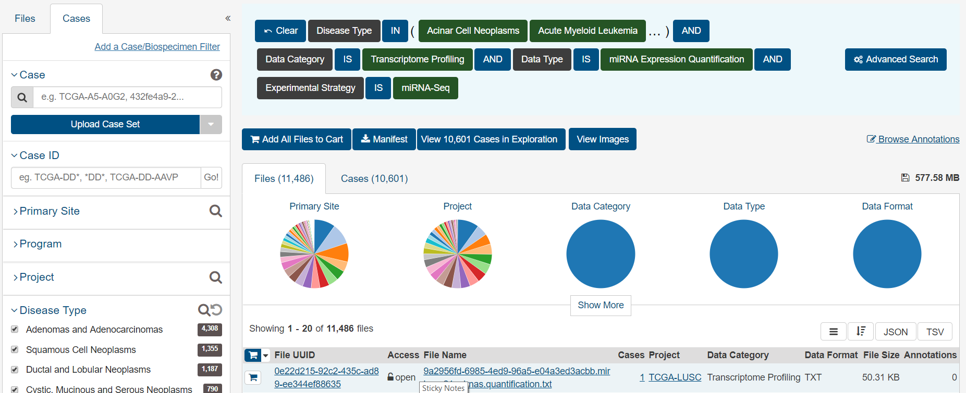
Data
GDC data is downloaded from the repository https://portal.gdc.cancer.gov/repository which contains information regarding more than 11,000 cancer cases.

Slide 3
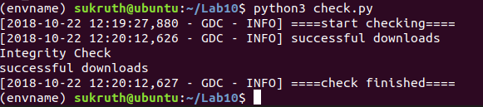
Integrity of downloaded files
MD5 checksum is used to check the integrity of the downloaded files.
GDC client is used for downloading the case files of cancer patients which are located in the gdc repository.

Slide 4
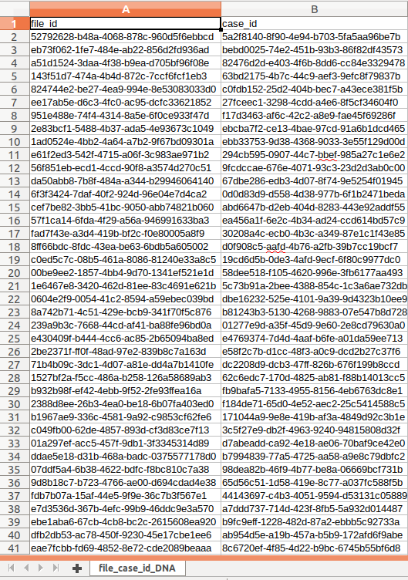
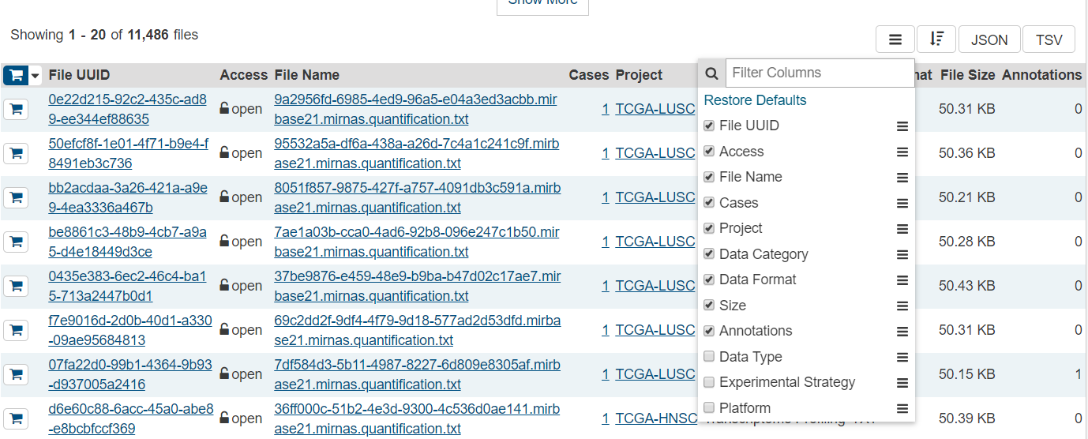

Extracting the file_id and case_id
Biomarker files are correlated with the corresponding case clinical / biospecimen files.

Slide 5

Extract Meta data
REST APIs are used for pulling the data from remote repositories.
Meta data is extracted for the files and corresponding cases
Include fields such as primary_site, disease_type etc..

Slide 6
Generate miRNA matrix
miRNA matrix consists of each case of disease with all the biological parameters
miRNA matrix is generated for all the files with label 0 for normal and label 1 for tumor.

Slide 7
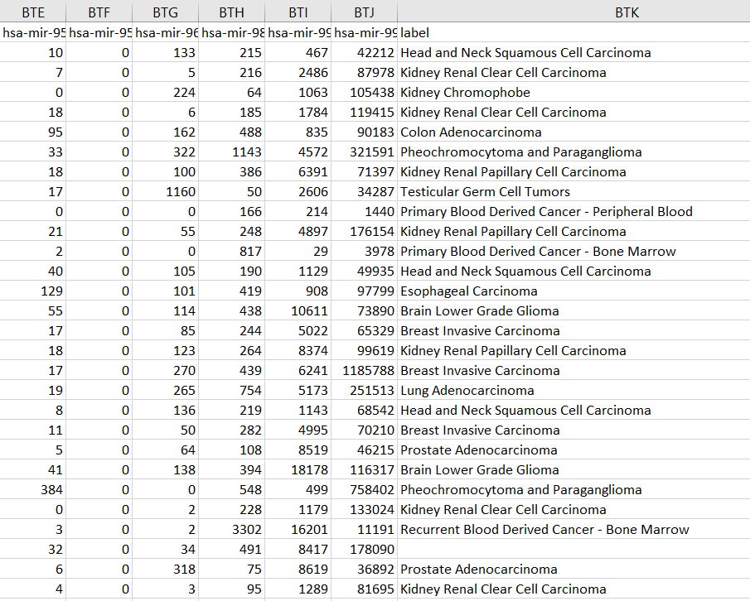
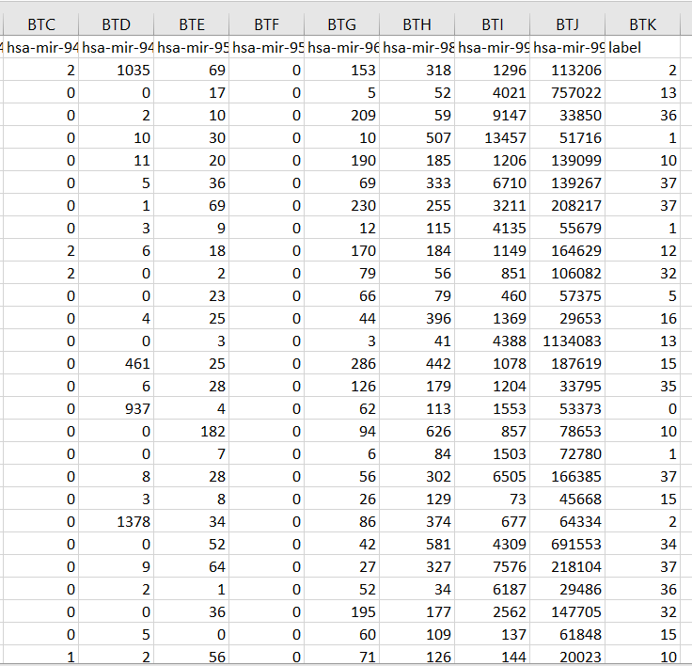
miRNA matrix
factorize

Slide 8
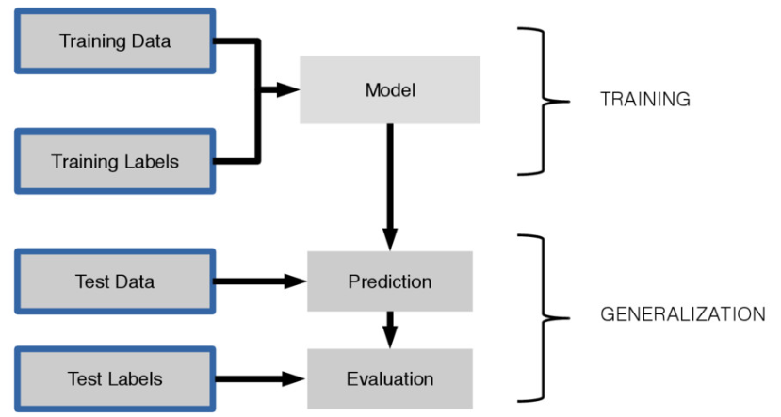
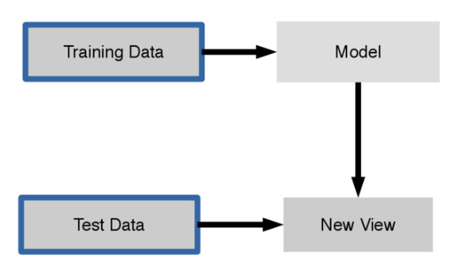
Apply Machine Learning Package
Supervised Learning: The goal is to approximate the mapping function so well that when you have new input data (x) that you can predict the output variables (Y) for that data.
Unsupervised Learning: The goal for unsupervised learning is to model the underlying structure or distribution in the data in order to learn more about the data.

Slide 9
Multi Layer Perceptron Classifier
MLP is a class of feedforward artificial neural network.
Consists of, at least, three layers of nodes: an input layer, a hidden layer and an output layer.
Each node is a neuron that uses a nonlinear activation function.
Utilizes a supervised learning technique called backpropagation for training.
x₁
x_{n}

Slide 10
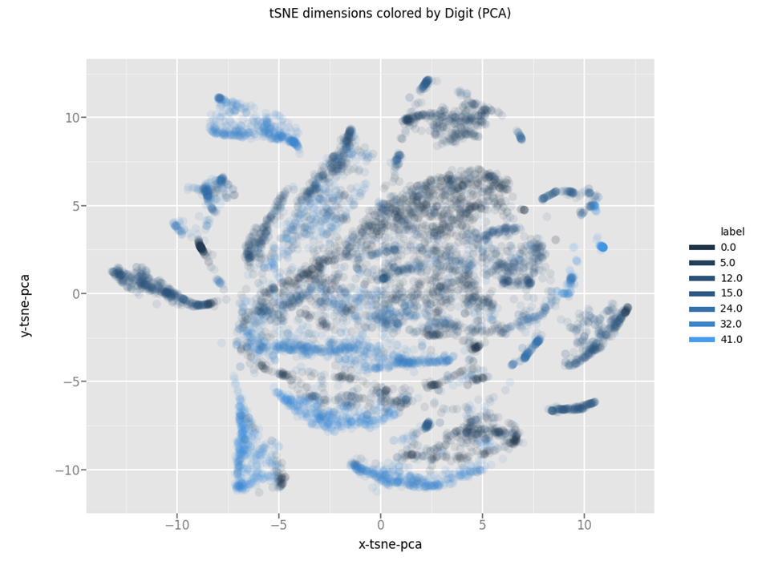
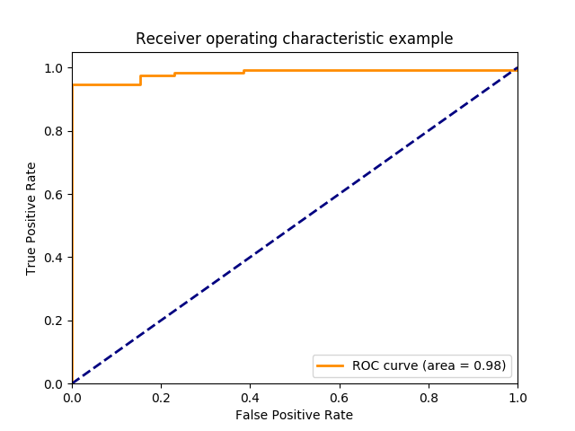
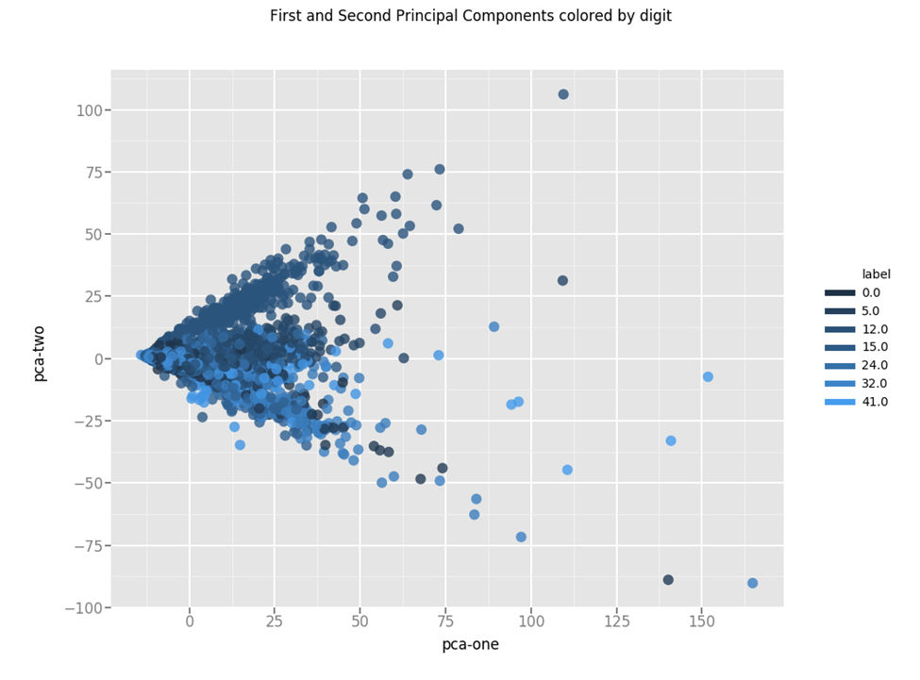
Feature Visualization
t-SNE Plot
ROC Curve
PCA Plot

Slide 11
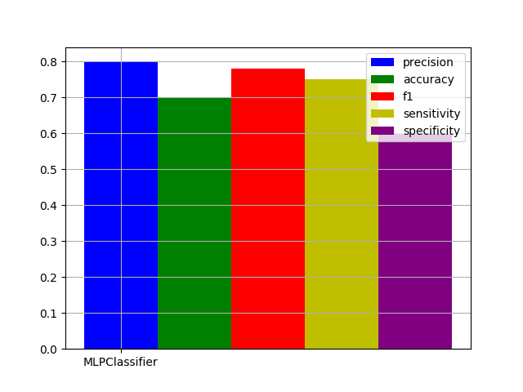
Performance Evaluation
Github link: https://github.com/raymoss/lab10.git

